Slide 1
EECE 229 Introduction to Digital Systems

Slide 2
Chapter 2
Boolean Algebra and Logic Gates

Slide 3
Boolean Algebra
The algebraic system usually used to work with binary logic expressions.
1. Closure | Any defined operation on (0, 1) gives (0,1)
2. Identity: | 0 + x = x ; | 1 . x = x
3. Commutative: | x + y = y + x ; | xy = yx
4. Distributive: | x (y + z) = xy + xz; | x + (yz) = (x + y)(x + z)
5. Def of Complement: | x + x’ = 1; | x x’ = 0
6. At least 2 elements (0 and 1)

Slide 4
The Duality Principle
Given a logic expression, its dual is obtained by replacing all + operator with . operator, and vice versa, and by replacing all 0s with all 1s, with versa.
Examples:
x + x’ = 1
so: xx’ = 0
x + y = y + x
so: xy = yx

Slide 5
Useful Postulates and Theorems
 | (a) | (b)
Postulate 2 | x + 0 = x | x . 1 = x
Postulate 5 | x + x’ = 1 | xx’ = 0
Theorem 1 | x + x = x | xx = x
Theorem 2 | x + 1 = 1 | x .0 = 0
Theorem 3 (involution) | (x’)’ = x
Postulate 3 (commutative) | x + y = y + x | xy = yx
Theorem 4 (associative) | x + (y + z) = (x + y) +z | x(yz) = (xy)z
Postulate 4 (distributive) | x(y + z) = xy + xz | x + yz = (x + y)(x + z)
Theorem 5 (deMorgan’s Law) | (x + y)’ = x’y’ | (xy)’ = x’ + y’
Theorem 6 (absorption) | x + xy = x | x (x + y) = x

Slide 6
Proving the Theorems
Theorem 1: x + x = x; xx = x
Proof:
x + x
= (x + x) 1
postulate
2(b)
= (x + x)(x + x’)
5(a)
= x + xx’
4(b)
= x + 0
5(b)
= x
2(a)
xx = x by duality

Slide 7
Proving by Truth Table
Two Boolean expressions are equal in all cases if and only if they have the same Truth Table.
You may use this to prove the expressions are equal.

Slide 8
Proving by Truth Table
Example: Prove deMorgan’s Law: (x + y)’ = x’y’
x | y | (x + y) | (x + y)’ | x’ | y’ | x’y’
0 | 0 | 0 | 1 | 1 | 1 | 1
0 | 1 | 1 | 0 | 1 | 0 | 0
1 | 0 | 1 | 0 | 0 | 1 | 0
1 | 1 | 1 | 0 | 0 | 0 | 0
The Truth Table of (x + y)’ is equal to
the Truth Table of x’y’, so we know that
(x + y)’ = x’y’
for all values of x and y.

Slide 9
Boolean functions and circuit equivalents

Slide 10
Implementing a Boolean expression as a circuit
F1 = x + y’z
x
F1
y’z
x
y’ z
y’z
F1
y
y’
x
y’z
F1
z

Slide 11
Simplifying expressions
There are many different ways to write the same expression
Example: x’y’z’ + x’yz + xy’ = xy’ + x’z
Different forms of the expression will require different numbers of gates to implement
Generally, longer expressions with more terms require more gates and/or more complex gates
More gates : higher power, higher cost, larger size, …
So finding a way to simplify expressions will pay off in terms of the circuits we design

Slide 12
A metric for use in simplifying expressions
Define a “literal” as each occurrence of a variable in the expression:
– Example: F2 = x’y’z + x’yz + xy’ → 8 literals
If we can write the expression with fewer literal, we will consider it to be simpler (and to take fewer gates).
Note that this is a rule of thumb and does not always give an optimum answer.

Slide 13
Simplifying expressions using the postulates and
theorems of Boolean Algebra
1. x(x’ + y)
= xx’ + xy
= 0 + xy
= xy
p4a p5b p2a
2. x+x’y
= x+y (the dual of 1)

Slide 14
Simplifying expressions using the postulates and
theorems of Boolean Algebra
3. (x+y)(x+y’) = x + yy’
= x+0
= x
p4a p5b p2a

Slide 15
Complementing a function
deMorgan’s Law says:
To take (A + B + C)’ Let y = B+C
(x + y)’ = x’y’
Then
(A + B + C)’ = (A + y)’ = A’y’ = A’(B + C)’ = A’B’C’
In general:
(A+B+C+D+…)’ = A’B’C’D’… ;
(ABCD…)’ = A’+B’+C’+D’…
A more complex function:
F = x’yz’ + x’y’z
F’ = (x’yz’ + x’y’z)’
= (x’yz’)’(x’y’z)’
= (x + y’ + z)(x + y + z’)

Slide 16
Another way: complementing a function
To complement a function, you can take the dual of the function, and complement each literal.
For the previous example:
F
= x’yz’ + x’y’z
dual of F
= (x’ + y + z’)(x’ + y’ + z)
so F’
= (x + y’ + z)(x + y + z’)

Slide 17
Standard forms of Boolean Expressions

Slide 18
Definitions
Product term
a term consisting of literals ANDed together
» Example: AB’F
Minterm
a Product term in which all variables appear
» Example: ABC’D where A,B,C, and D are the variables of the function
Sum term
a term consisting of literals ORed together
» Example: A + B’ + F
Maxterm
a Sum term in which all variables appear
» Example: A + B + C + D where A, B, C, and D are the variables of the function

Slide 19
SOP and Canonical SOP Form
A function is in Sum of Products (SOP) form if it is written as product terms ORed together
– Example: f(x y z) = xy’z + xz + y
A function is in Canonical SOP form if it is in SOP form and all terms are minterms
– Example: g(x y z) = xy’z + x’yz + xyz

Slide 20
POS and Canonical POS form
A function is in Product of Sums (POS) form if it is written as sum terms ANDed together
– Example: f(x y z) = (x + y + z) ( x + z’) (y)
A function is in Canonical POS form if it is written in POS form and all terms are Maxterms
– Example: g(x y z) = (x’ + y’ + z’) ( x + y + z)

Slide 21
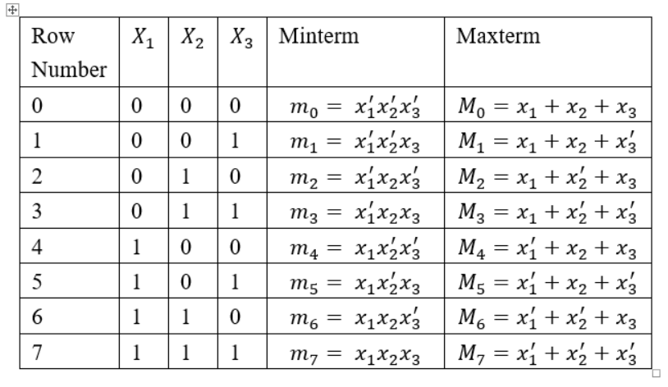
Three-variable minterms and maxterms

Slide 22
Three-variable minterms and maxterms

Slide 23

Minterms and the Truth Table
Each row of a Truth Table corresponds to a minterm.
x | y | z | f(x y z) |  | minterm
0 | 0 | 0 | 0 |  | x’ y’ z’
0 | 0 | 1 | 1 | m₁ | x’ y’ z
0 | 1 | 0 | 0 | m₂ | x’ y z’
0 | 1 | 1 | 0 | m₃ | x’ y z
m₀
The 1’s of the Truth Table show the minterms that are
in the Canonical SOP expression
1 | 0 | 0 | 1 | m₄ | x | y’ z’
1 | 0 | 1 | 1 | m₅ | x | y’ z
1 | 1 | 0 | 0 | m₆ | x | y z’
1 | 1 | 1 | 1 | m₇ | x | y z | f(x y z) = x’y’z + xy’z’ + xy’z + x y z
Minterm List Form: f(x y z) =
m(1, 4, 5, 7)
Row numbers

Slide 24
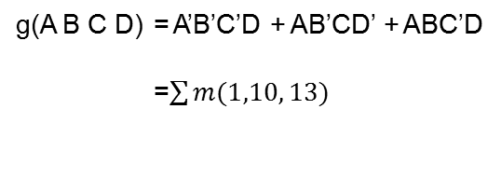
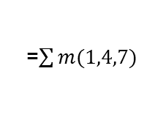
Examples
x | y | z | f(xyz)
0 | 0 | 0 | 0
0 | 0 | 1 | 1
0 | 1 | 0 | 0
0 | 1 | 1 | 0
1 | 0 | 0 | 1
1 | 0 | 1 | 0
1 | 1 | 0 | 0
1 | 1 | 1 | 1
A B C D
g(ABCD)
0 | 0 | 0 | 0 | 0
0 | 0 | 0 | 1 | 1
0 | 0 | 1 | 0 | 0
0 | 0 | 1 | 1 | 0
0 | 1 | 0 | 0 | 0
0 | 1 | 0 | 1 | 0
0 | 1 | 1 | 0 | 0
0 | 1 | 1 | 1 | 0
1 | 0 | 0 | 0 | 0
1 | 0 | 0 | 1 | 0
1 | 0 | 1 | 0 | 1
1 | 0 | 1 | 1 | 0
1 | 1 | 0 | 0 | 0
1 | 1 | 0 | 1 | 1
1 | 1 | 1 | 0 | 0
1 | 1 | 1 | 1 | 0
f(x y z)
= x’y’z + xy’z’ + xyz
=$\sum{m(1,4,7)}$
g(A B C D) = A’B’C’D + AB’CD’ + ABC’D
=$\sum{m(1,10, 13)}$

Slide 25

Maxterms and the Truth Table
Each row of a Truth Table corresponds to a maxterm.
Note the differences from the way minterms are complemented
x y z f(x y z) Maxterm
0 | 0 | 0 | 0 | M₀ | x | + y + z
0 | 0 | 1 | 1 | M₁ | x | + y + z’
0 | 1 | 0 | 1 | M₂ | x | + y’ + z
0 | 1 | 1 | 0 | M₃ | x | + y’ + z’
The 0’s of the Truth Table show the maxterms that are
in the Canonical POS expression
1 | 0 | 0 | 1 | M₄ | x’ + y + z
1 | 0 | 1 | 1 | M₅ | x’ + y + z’
1 | 1 | 0 | 0 | M₆ | x’ + y’ + z
1 | 1 | 1 | 1 | M₇ | x’ + y’ + z’ | f(x y z) = (x+y+z)(x+y’+z)(x’+y’+z)
Maxterm List Form: f(x y z) =
M(0,3,6)

Slide 26



Example
x | y | z | f(xyz)
0 | 0 | 0 | 0
0 | 0 | 1 | 1
0 | 1 | 0 | 0
0 | 1 | 1 | 0
1 | 0 | 0 | 1
1 | 0 | 1 | 0
1 | 1 | 0 | 0
1 | 1 | 1 | 1
f(x y z) = (x+y+z)(x+y’+z)(x+y’+z’)(x’+y+z’)(x’+y’+z)
=$ΠM(0, 2, 3, 5, 6)$
Note that the Minterm List and Maxterm List taken together include the number of every row of the Truth Table. That means that if you determine either one of the lists, you can determine the other one by simply writing the row numbers that are not in the first one.
Examples:
If F(ABC) = m(0-3), then F(ABC) = M(4-7)
if G(wxyz) = M(0,12,15), then G(wxyz) = m(1-11, 13, 14)

Slide 27
Basic Combinational Circuit Designs

Slide 28
Review: Digital Logic Gates
x
=
0
x
=
1
(a) Two states of a switch
S
x
(b) Symbol for a switch
A binary switch.

Slide 29
Review: Digital Logic Gates
Consider a simple application of a switch, where the switch turns a small lightbulb on or off.
Describe the state of light as a function of the input variable x. L=1, if x=1. L=0, if x=0.
L(x) = x
S
Power
supply
x
Light
A light controlled by a switch

Slide 30
S
S
Power
x₁
x₂
supply
Light
(a) The logical AND function (series connection)
S
x₁
Power
Light
supply
S
x₂
(b) The logical OR function (parallel connection)
Notes:
L=X1+X2; X1=1, X2=1, L=1
L=X1*X2; X1=1, X2=0, L=1;

Slide 31
Review: Digital Logic Gates
An extra resister to ensure that the closed switch does not short-circuit the power supply.
R
Power
supply
x
S
Light
An inverting circuit
Notes:
L=x’ x=1, L=0; x=0, L=1;

Slide 32



Review: Digital Logic Gates
NOT
AND
OR
A
F = A’
A B
F = AB
A B
F = A+B
0
1
1
0
0
0
0
1
0
0
0
0
0
1
0
1
1 0
0
1 0
1
1
1
1
1
1
1

Slide 33
Review: Digital Logic Gates
Three-input AND and OR operations.

Slide 34
x
1
x
2
x
1
⋅
⋅
…
x
x
⋅
x
⋅
x
1
x
1
2
n
x
2
2
x
n
(a) AND gates
x
1
x
x
2
1
x
+
x
x
+
x
+
…
1
2
1
2
+
x
x
n
2
x
n
(b) OR gates
x
x
(c) NOT gate

Slide 35
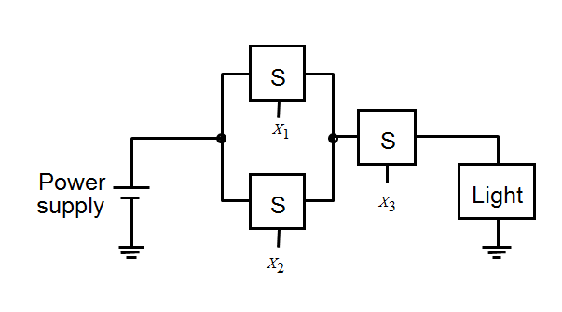
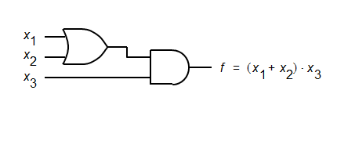
Review: Digital Logic Gates

Slide 36
SOP to “AND-OR”
An SOP expression can be directly implemented in a two-level combinational circuit with an AND gate for each product term and an OR gate to combine the terms.
Example:
f(xyz) = x + x’y + x’y’z
x
x’
y
f(xyz)
x’
y’ z

Slide 37
POS to “OR-AND”
A POS expression can be directly implemented in a two-level combinational circuit with an OR gate for each sum term and an AND gate to combine the terms.
Example:
f(wxyz) = z’(x+y)(w+z)
z’
x y
w z
f(wxyz)

Slide 38
Circuits for mixed-form expressions
Combinational circuits for mixed-form expressions may have more than two levels.
Example:
f(ABCDE) = AB + C(D + E)
A B C
D E
f(ABCDE)

Slide 39
Other common gate types
NAND
NOR
x y
x
y
(xy)’ = x’ + y’
(x+y)’ = x’y’
x y x NAND y
x y x NOR y
0 | 0
0 | 1
1 | 0
1 | 1
1
1
1
0
0 0
0 1
1 0
1 1
1
0
0
0
Exclusive-OR (XOR)
x y
xy’ + x’y
= x + y
x | y | x | XOR y
0 | 0 |  | 0
0 | 1 |  | 1
1 | 0 |  | 1
1 | 1 |  | 0

Slide 40
AND, OR, and NOT Convert to NAND and NOR
x
NOT
x
(xx)’ = x’
(x+x)’ = x’
x
x y
AND
((xy)’)’ = xy
(x’+y’)’
= x’’y’’
= xy
y
x
OR
x y
(x’y’)’ = x+y
((x+y)’)’ = x+y
y

Slide 41
SOP to NAND (1)
We already determined that we can go directly from SOP form to an AND-OR implementation
f(xyz) = x + x’y + x’y’z
x
x’ y
f(xyz)
x’
y’ z
We can substitute the NAND equivalents for the AND and OR gates x
x’ y
x’
f(xyz)
y’ z

Slide 42
SOP to NAND (2)
The circled gates are just 2 inverters in series – they do nothing
x
x’ y
x’
f(xyz)
y’ z
So leave them out
x
x’ y
x’
f(xyz)
y’ z

Slide 43
SOP to NAND (3)
x
x’ y
x’
f(xyz)
y’ z
Check: Is this still the original f(xyz)?
The circuit produces:
(x’(x’y)’(x’y’z))’ = x’’ + (x’y)’’ + (x’y’z)’’ = x + x’y + x’y’z

Slide 44
SOP to NAND (4)
We can use NAND gates to directly implement any SOP expression:
One NAND for each Product term
One NAND to sum the terms
Invert any single inputs
Why do we do this?
The NAND integrated circuit design is very simple.
We can use this one simple gate type for any expression.

Slide 45
Using NAND gates to implement a sum-of-products
x
1
x
1
x
2
x
2
x
3
x
3
x
4
x
4
x
5
x
5
x
1
x
2
x
3
x
4
x
5

Slide 46
Using NOR gates to implement a product-of sums
x
x
1
1
x
x
2
2
x
x
3
3
x
x
4
4
x
x
5
5
x
1
x
2
x
3
x
4
x
5

Slide 47
SOP to NAND (5)
Example:
f(A,B,C,D) = A’B + AC + ABD’
A’ B
A
C
f(A,B,C,D)
A
B
D’

Slide 48
Cascading 2-input NANDs to implement
larger NAND functions
Think of a multiple-input NAND as an AND followed by an INVERTER
x y z
(xyz)’
x y z
(xyz)’
We can easily build a multiple-input AND out of 2-input ANDs
x y z
x y z
xyz
xyz
And we know how to build a 2-input AND from 2-input NANDs
y z
y z
yz
(yz)’’ = yz
Substituting
x
y
z
(x (yz)’’)’ = (xyz)’

Slide 49
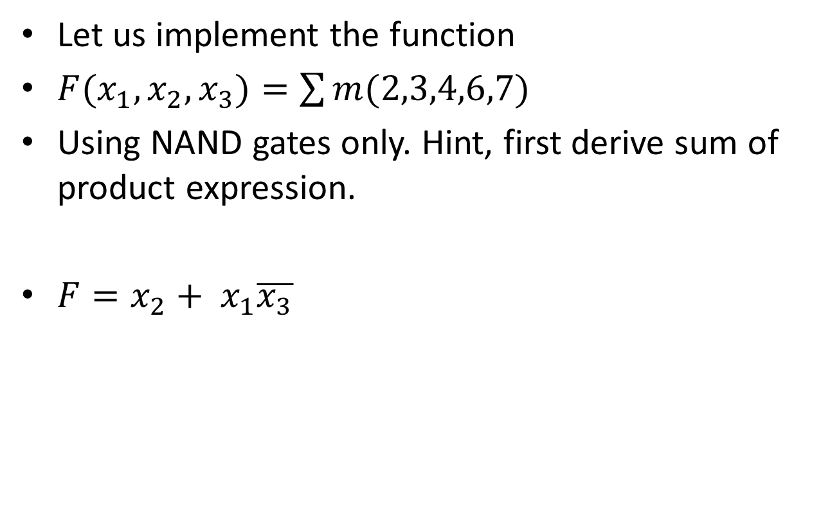
Example
Let us implement the function
$F(x_{1},x_{2},x_{3})=\sum{m(2,3,4,6,7)}$
Using NAND gates only. Hint, first derive sum of product expression.
$F=x_{2}+ x_{1}\overline{x_{3}}$

Slide 50
x₁
f
x₂
x₃
(a) SOP implementation
x₁
x₂
f
x₃
(b) NAND implementation

Slide 51
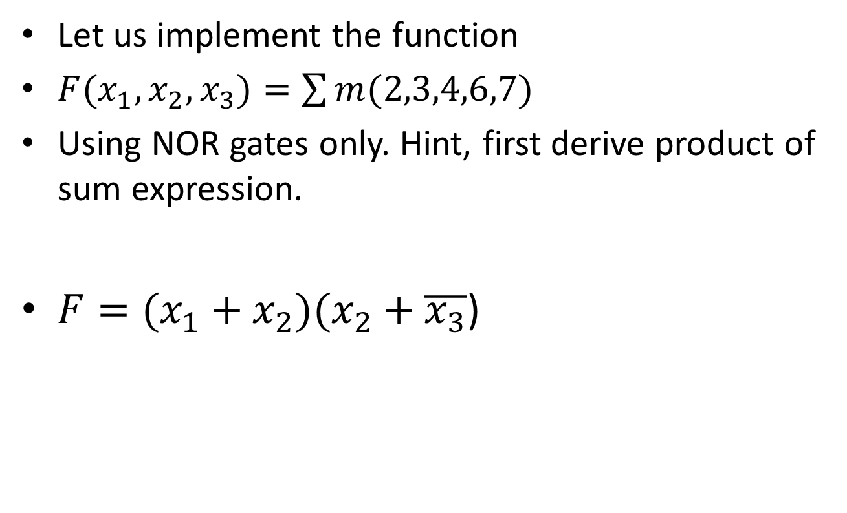
Example
Let us implement the function
$F(x_{1},x_{2},x_{3})=\sum{m(2,3,4,6,7)}$
Using NOR gates only. Hint, first derive product of sum expression.
$F=(x_{1}+x_{2})(x_{2}+\overline{x_{3}}$)

Slide 52
x₁
x₂
f
x₃
(a) POS implementation
x₁
x₂
f
x₃
(b) NOR implementation
NOR-gate realization of the function

Slide 53
Synthesis
The process where by we begin with a description of the desired functional behavior, then generate a circuit that realizes this behavior is called synthesis.
Truth Table -> Logic Expression -> Logic Circuit

Slide 54
Gate-Level Minimization

Slide 55
Karnaugh Maps (“K-Maps”)
Based on the Theorem: xA’ + xA = x(A’ + A) = x
This means that two product terms that differ only in one literal (the literal is complemented in one term and uncomplemented in the other) can be grouped to form a single term without that literal. Call terms like this “logically adjacent”.
examples:
w’x’yz + wx’yz = x’yz
ab’ + ab = a
xyz + xy’z + xy’z’ + x’y’z’ = xz + y’z’

Slide 56
Extending the theorem
Notice that all possible combinations of A and B are included here
xA’B’ + xA’B + xAB’ + xAB = xA’(B’ + B) + xA(B’ + B)
= xA’ + xA
= x
The theorem extends to any number of terms that is a power of 2

Slide 57
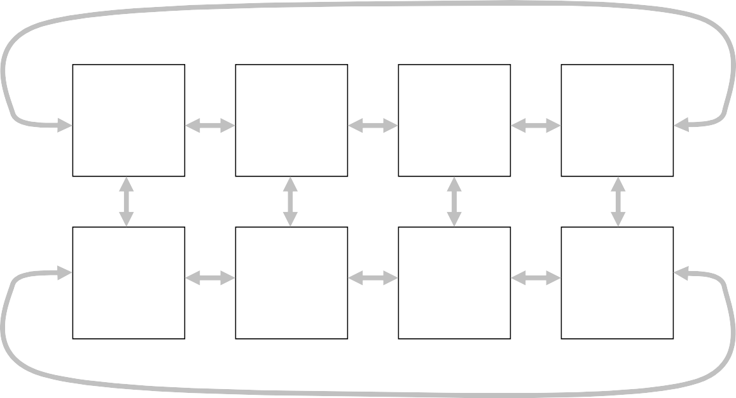
Logically-adjacent minterms
The Karnaugh Map (“K-Map”) is a diagram that arranges the minterms so that if two Minterms are Logically Adjacent, they are physically adjacent in the diagram.
For 3 variables
m0 000 x’y’z’ | m1 001 x’y’z | m3 011 x’yz | m2 010 x’yz’
m4 100 xy’z’ | m5 101 xy’z | m7 111 xyz | m6 110 xyz’
This gives a convenient way to combine logically-adjacent terms

Slide 58
2-variable Karnaugh Map
_{x} y
x | y | f
0 | 0 | 0 | 0 | 0 | 1
0 | 1 | 1
1 1 | 0 1 | 0 1 | 1 | 0 | 1
0
1
_{x} y
0
1
x | y | f
0 | 0 | m0 | 0 | m0 | m2
0 | 1 | m1
1 1 | 0 1 | m2 m3 | 1 | m1 | m3
m₂ + m₃ = x’y + xy
=(x+x’)y
= y

Slide 59
2-variable Karnaugh Map
_{x} y
0
1
x | y | f
0 | 0 | 0 | 0 | 0 | 1
0 | 1 | 1
1 1 | 0 1 | 1 1 | 1 | 1 | 1

Slide 60
Grouping
_{x} y
0
1
0 0
1
1 1
1
We can group 2
adjacent terms on the K-Map.
The resulting term contains those literals that are common to all of the grouped terms.
In the example above, we grouped minterms xy’ and xy
The result is
x

Slide 61
Grouping
_{x} y
0
1
0 0
1
1 1
1
Note that it’s OK to use a minterm more than once.

Slide 62
The K-Map produces the same results as algebraic
simplification (faster)
_{x} y
0
1
x | y | f
0 | 0 | 0 | 0 | 0 | 1
0 | 1 | 1
1 1 | 0 1 | 1 1 | 1 | 1 | 1
Algebraically:
f(x,y) = x’y + xy’ + xy
= x’y + xy’ + xy + xy
= x’y + xy + xy’ + xy
= (x’+x)y + x(y’+y)
= y + x
f(x,y) = y + x

Slide 63
3-variable K-Maps
x
yz
00 01 11 10
0
1
m₀ | m₁ | m₃ | m₂
m₄ | m₅ | m₇ | m₆
End cells are adjacent

Slide 64
Example 1
f(𝑥,𝑦,𝑧)=∑𝑚(2−5)
x
yz
00 01 11 10
0
0
1
3
1
2
1
4
5
7
6
1 1
1
f(x,y,z) = xy’ + x’y

Slide 65
Example 2
f(𝑥,𝑦,𝑧)=∑𝑚(3,4,6,7)
x
yz
00 01 11 10
0
0
1
3
1
2
4
5
7
6
1 1
1
1
f(x,y,z) = xz’ + yz

Slide 66
Example 3
f(𝑥,𝑦,𝑧)=∑𝑚(0,1, 3, 4, 5)
x
yz
00 01 11 10
0
1
0 | 1 | 1 | 1 | 3 1 | 2
4 |  | 5 |  | 7 | 6
 | 1 |  | 1
f(x,y,z) = y’ + x’z

Slide 67
Mapping SOP expressions onto the K-Map
For each product term, write 1 in every cell that is in the “intersection” of the literals in the term
x’yz’
xz
x
yz
00 01 11 10
yz
00 01 11 10
0 | 1 | 3 | 2 1
4 | 5 | 7 | 6
x
0
x’
0
0 | 1 | 3 | 2
4 | 5 1 | 7 1 | 6
1
1
yz’
y’ + x’z
00 01 11 10
xy’ + x’z’ + y’z’ 00 01 11 10
x
yz
yz
0 | 1 | 1 | 1 | 3 1 | 2
4 |  | 5 |  | 7 | 6
 | 1 |  | 1
x
0 | 1 | 1 |  | 3 | 2 1
4 |  | 5 |  | 7 | 6
 | 1 |  | 1
0
0
1
1

Slide 68
Grouping
Get simpler expression for bigger grouping
x
yz
00 01 11 10
yz
00 01 11 10
0 | 1 | 1 | 1 | 3 | 1 | 2
4 |  | 5 |  | 7 |  | 6
 | 1 |  | 1 |  | 1
x
0
0
0 | 1 | 1 | 1 | 3 | 1 | 2
4 |  | 5 |  | 7 |  | 6
 | 1 |  | 1 |  | 1
1
1
f(x,y,z) = y’ + yz
f(x,y,z) = y’ + z

Slide 69
Grouping
Must cover all terms, but covering terms more than once increases complexity
x
yz
00 01 11 10
yz
00 01 11 10
0 | 1 | 1 |  | 3 |  | 2
4 |  | 5 |  | 7 |  | 6
 | 1 |  | 1 |  | 1
x
0
0
0
1
1
3
2
1
4
5
7
6
1 1
1
1
f(x,y,z) = y’z’ + xz
f(x,y,z) = y’z’ + xz + xy’

Slide 70
4 variable K-Maps
yz ₀₀
01 11 10
Top and Bottom Are adjacent
wx
m₀ | m₁ | m₃ | m₂
m₄ | m₅ | m₇ | m₆
^{m}12 | ^{m}13 | ^{m}15 | ^{m}14
m₈ | m₉ | ^{m}11 | ^{m}10
00
01
11
10
Sides are adjacent
Note that
The 4 corners are adjacent to each other

Slide 71


Grouping
$f(w, x,y,z)=$∑𝑚(0,1, 10, 11, 14, 15)
yz ₀₀
01 11 10
wx
0 1 | 1 1 | 3 | 2
4 | 5 | 7 | 6
12 | 13 | 15 1 | 14 1
8 | 9 | 11 1 | 10 1
00
01
11
10
$$f(w, x,y,z) = w’x’y’ + wy$$

Slide 72


Crossing the sides
$f(w, x,y,z)=$∑𝑚(0-2, 4-6, 8, 9, 12-14)
yz ₀₀
wx
0
1 3 2
00
1
1 1
4
1
5
7 6
01
1 1
11
12
1
13
1
15 14
1
11 10
8
9
10
1 1
$$f(w, x,y,z) = y’ + w’z’ + xz’$$

Slide 73
Crossing top and bottom, grouping corners
F(A,B,C,D) = A’B’C’ + B’CD’ +A’BCD’ + AB’C’
CD ₀₀
01 11 10
AB
0
1
3 2
00
1
1 1
01
4
5
7 6
1
11
12
13
15
14
8
9
11
10
10
1 1
1
F(A,B,C,D) = B’C’ + B’D’ + A’CD’

Slide 74

Complementing with K-Maps
To simplify the complemented expression, group the 0’s
yz ₀₀
01 11 10
wx
00 | 0 | 1 | 1 | 1 | 3 | 0 | 2 | 0
 | 4 |  | 5 |  | 7 |  | 6
01 |  | 0 |  | 0 |  | 0 |  | 0
 | 12 |  | 13 |  | 15 |  | 14
11 |  | 0 |  | 0 |  | 1 |  | 1
10 | 8 | 0 | 9 | 0 | 11 | 1 | 10 | 1
$f(w, x,y,z)=$∑𝑚(0,1, 10, 11, 14, 15)
$$f ’(w, x,y,z) = w’y + w’x + wy’$$

Slide 75
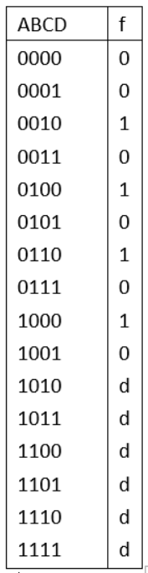

“Don’t Cares”
Sometimes we don’t care if a the result of evaluating a Boolean expression for a particular minterm gives a 0 or 1. This often happens because the combination of literals represented by the minterm cannot occur.
Example: f(ABCD)=1 if the BCD digit ABCD is even (not 0)
$f(w, x,y,z)=$∑𝑚(2,4,6,8) + ∑d(10-15)

Slide 76

Consider don’t cares by treating them as if d is 1
$f(w, x,y,z)=$∑𝑚(2,4,6,8) + ∑d(10-15)
If we treated all don’t cares as 1:
CD ₀₀
01 11 10
AB
0
1
3
2
00
1
01
4
1
5
7
6
1
12
13
15
14
11 d
d
d
d
8
1
9
11
10
10
d d
$$f(ABCD) = BD’ + AB + AD’ + CD’ (8 literals)$$

Slide 77

Consider don’t cares by treating them as if d is 0
$f(w, x,y,z)=$∑𝑚(2,4,6,8) + ∑d(10-15)
If we treated all don’t cares as 0:
CD ₀₀
01 11 10
AB
0
1
3
2
00
1
01
4
1
5
7
6
1
12
13
15
14
11 d
d
d
d
8
1
9
11
10
10
d d
$$f(ABCD) = A’CD’ + A’BD’ + AB’C’D’ (10 literals)$$

Slide 78

The best approach
treat d’s as 1 where they help make larger groups for the “real” 1’s
treat them as 0 where they do not.
$f(w, x,y,z)=$∑𝑚(2,4,6,8) + ∑d(10-15)
CD ₀₀
01 11 10
AB
0
1
3
2
00
1
01
4
1
5
7
6
1
12
13
15
14
11 d
d
d
d
8
1
9
11
10
10
d d
$$f(ABCD) = CD’ + BD’ + AD’ (6 literals)$$

Slide 79

Example
$f(w, x,y,z)=$∑𝑚(1,3,7,11,15) + ∑d(0,2,5)
yz
00 01 11 10
yz
00 01 11 10
wx
00
0 d | 1 1 | 3 1 | 2 d
4 | 5 d | 7 1 | 6
12 | 13 | 15 1 | 14
8 | 9 | 11 1 | 10
wx
00
0 d | 1 1 | 3 1 | 2 d
4 | 5 d | 7 1 | 6
12 | 13 | 15 1 | 14
8 | 9 | 11 1 | 10
01
01
11
11
10
10
f(wxyz) = yz + w’x’
f(wxyz) = yz + w’z

Slide 80
Conclusion
Boolean algebra
Simplify expressions using Boolean algebra (postulates and theorems)
Standard forms of Boolean expressions (Minterms and Maxterms, SOP, POS)
Synthesis (basic circuit designs using SOP or POS)
Using NAND gates/NOR gates to implement SOP/POS
Gate level minimization K-maps (three variables/four variables, don’t cares)

